Slide 1
12 Lambda/2 Resonators Design
Will be used for:
Ta project
Ta wafer
NbTiN wafer
Figen Yilmaz

Slide 2
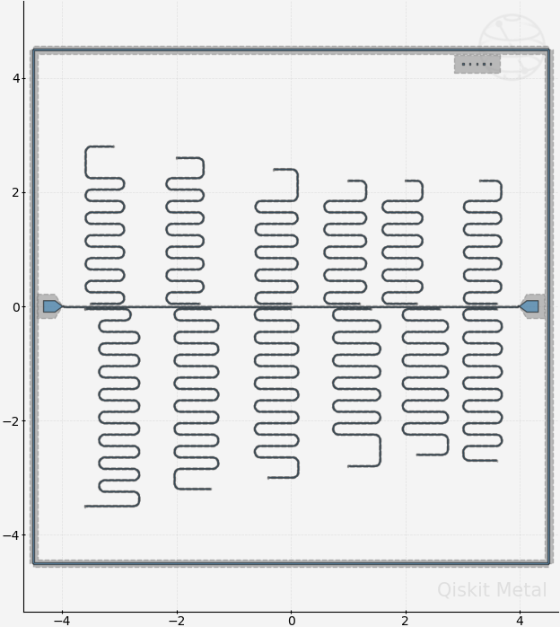
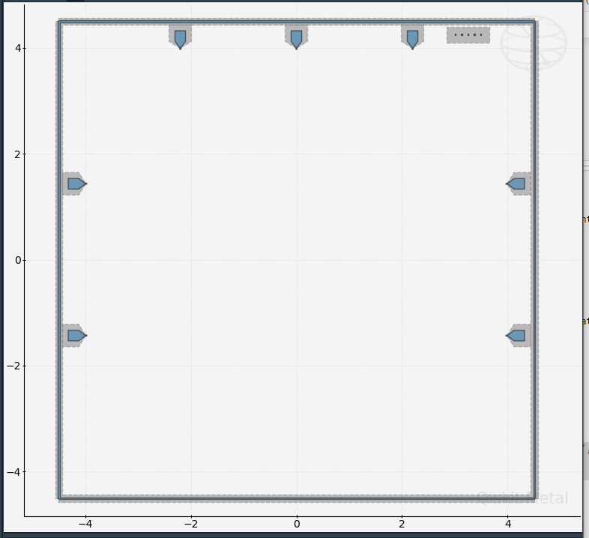
12 resonator design version 2
Was happy with this design ☺
Later, Martijn hit me with the new PCB design like our PhD life hits us :P

Slide 3
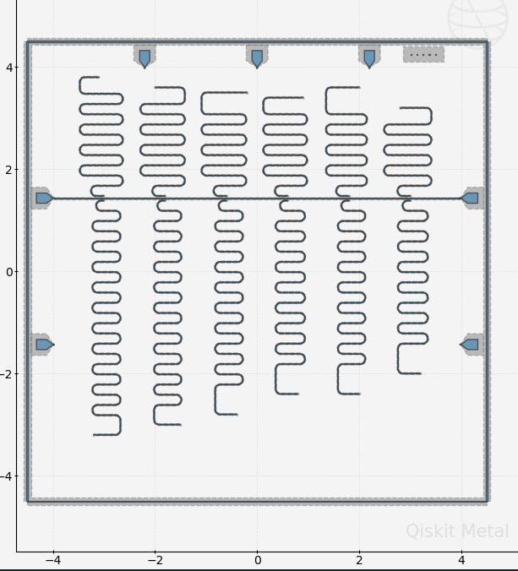
12 resonator design version 3
One more change is needed! Why?
1) Just because these resonators look ugly to me :P
Serious answer is that the resonators on top, they are fatty (dombili case). Not enough space up there.

Slide 4
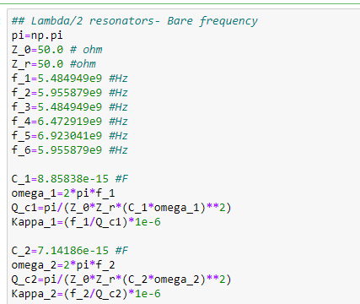
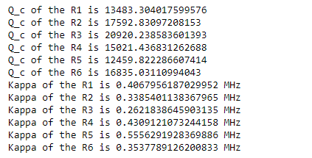
12 resonator design version 3
Calculated Kappa and Q_c
After having a meeting C.K.A:
Increase Qc to at least a few 100K for the first 6 resonators
For the rest of the resonators, let’s have less than 100K

Slide 5
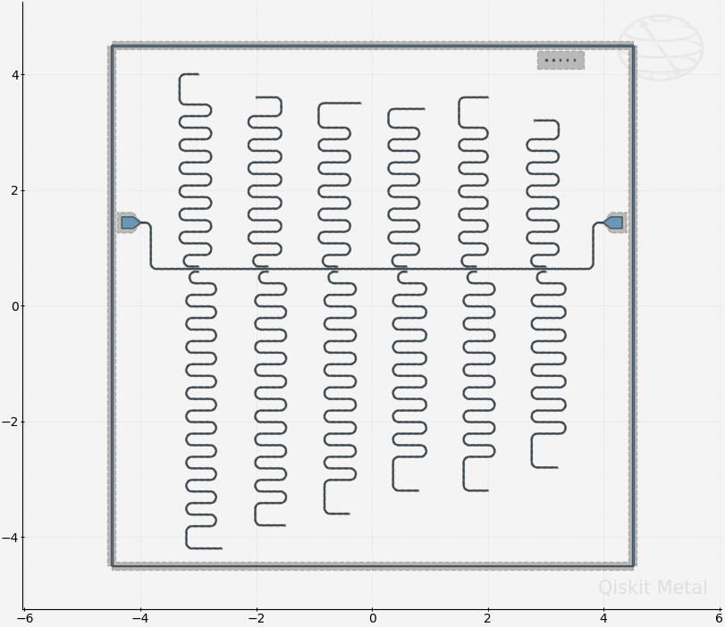
12 resonator design version 4
Finally, Figen can sleep and snore again

Slide 6
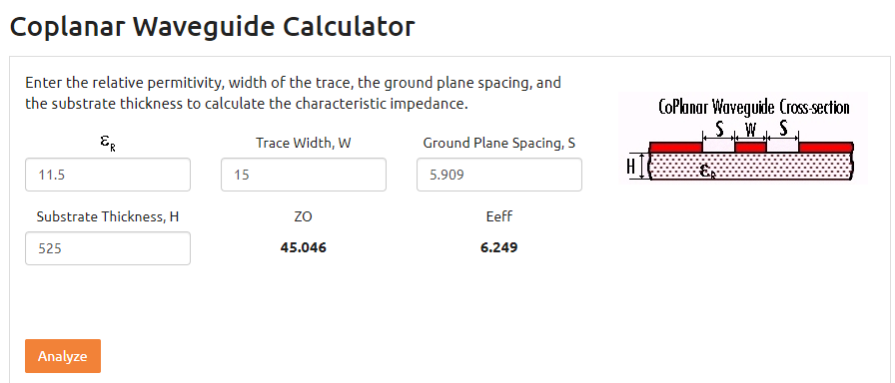

12 resonator design version 4
Silicon Relative permitivity at low tempratures is 11.5 [1].
Resonator’s cpw_width vs cpw_gap calculation to have $Z_{0}=45 Ohm [2]$.
Ref [1]: https://journals.aps.org/prapplied/pdf/10.1103/PhysRevApplied.18.034013
Ref [2]: CPW calculator

Slide 7
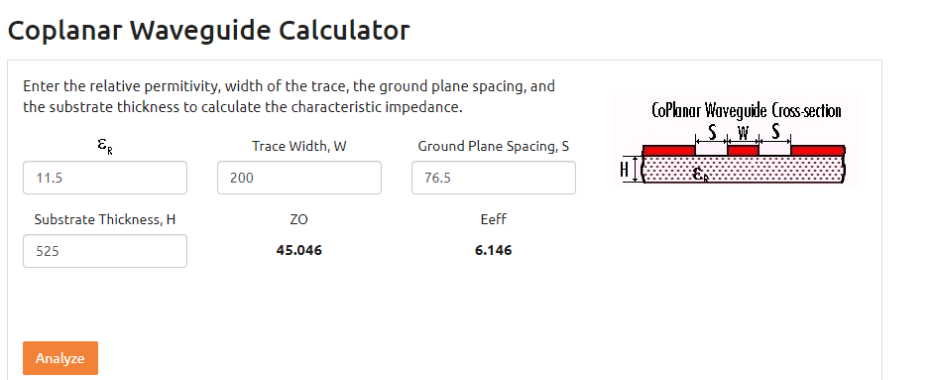

12 resonator design version 4
Silicon Relative permitivity at low tempratures is 11.5 [1].
Launch pad vs launch gap calculation to have $Z_{0}=45 Ohm [2]\text{.}$
Ref [1]: https://journals.aps.org/prapplied/pdf/10.1103/PhysRevApplied.18.034013
Ref [2]: CPW calculator

Slide 8
12 resonator design version 4
Resonator number | total_length (mm) | frequency (GHz)
1 | 14.8 | 4.019206
2 | 13.84 | 4.299681
3 | 12.80 | 4.644329
4 | 12.0 | 4.949448
5 | 11.4 | 5.211088
6 | 10.792 | 5.498372
7 | 10.20 | 5.824121
8 | 9.7 | 6.12071
9 | 9.15 | 6.483738
10 | 8.80 | 6.751946
11 | 8.46 | 7.018817
12 | 8.12 | 7.319546

Slide 9
12 resonator design version 4
Resonator number | total_length (mm) | frequency (GHz)
1 | 13,20 | 4.50 | 4.502
2 | 12.40 | 4.80 | 4.794
3 | 12.00-11,70-11,68 | 5.10 | 4.644329 | 4,951-5,074-4,641
4 | 11,00 | 5.40 | 5.406
5 | 11.00-10,30-10,33-10,36 | 5.70 | 5,747 | 5,396-5,767
6 | 9.80 | 6.00 | 6.056
7 | 10.20- | 6.30 | 5.824121
8 | 9.7- | 6.60 | 6.12071
9 | 9.15- | 6.90 | 6.483738
10 | 8.80- | 7.20 | 6.751946
11 | 8.46- | 7.50 | 7.018817
12 | 8.12- | 7.80 | 7.319546

Slide 10
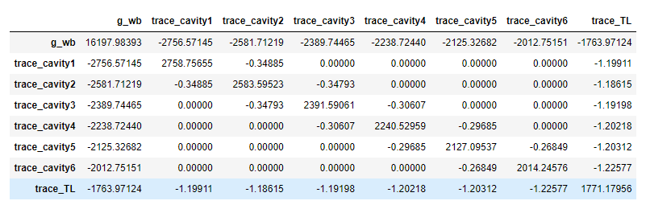
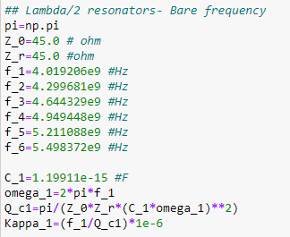
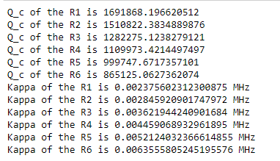
12 resonator design version 4

Slide 11
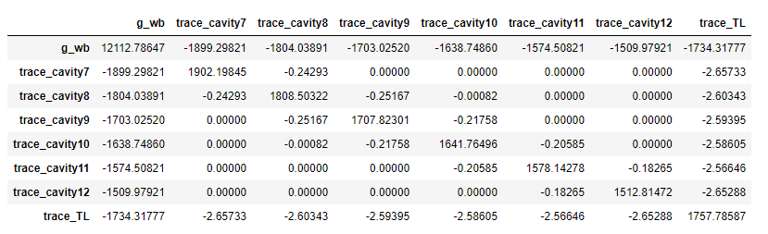
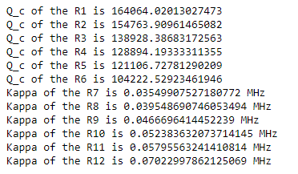
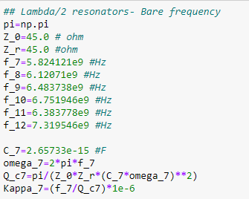
12 resonator design version 4

Slide 12
After the meeting with C.K.A on the 22.06.23
Res frequencies should start from 4.5 GHz because NbTiN have a kinetic inductance
Qc can be a bit different than each other but arrange them as higher freq

